Slide 1
VAULT
A shared distributed and redundant storage solution

Slide 2

Meet the team
IT16106420 | T.R.N.R Peiris
IT16158528 | K.V.A Sachintha
IT16016026 | B.A Ganegoda
IT16091276 | W.M.U.K.M.T Bandara

Slide 3
Outline

Slide 4
Problem Definition
Proposed Solution
Research Methodology
System Architecture & Process
Similar applications
Objectives
Tools / Techniques
Commercialization and Expected Outcomes

Slide 5
Problem Definition

Slide 6
Wastage of Unused Storage
Example:
Large-scale corporations that use thousands of workstations for their employees have hundreds of terabytes of unused free space in their hard drives.
Notes:
Add content here to explain while presenting

Slide 7
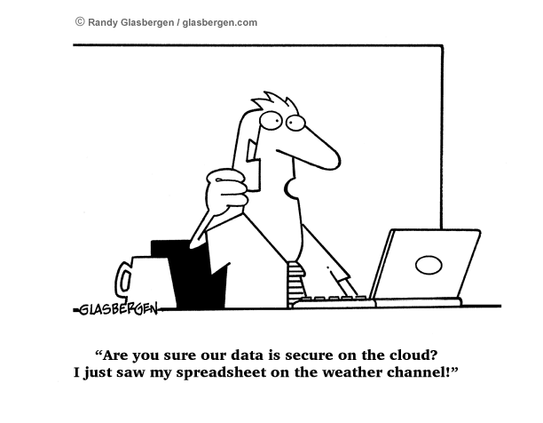
Security
Notes:
Add content here to explain while presenting

Slide 8
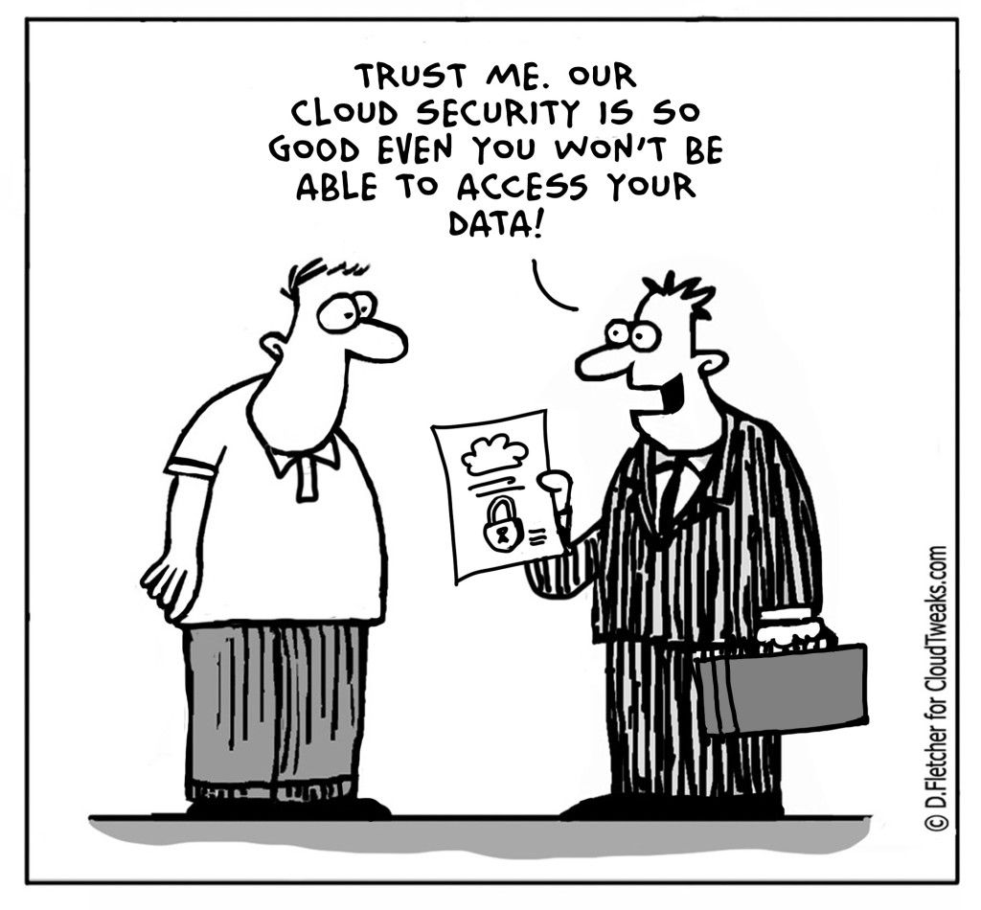
Availability
Can cloud storage ensure availability?
AWS multi AZ (Availability Zone) failure (2017)
Network link failures
Network edge layer failures
Notes:
Add content here to explain while presenting

Slide 9
Storage and transfer costs
Cloud Storage subscription costs.
AWS
GCP
Onsite NAS setup and maintenance costs
Data transfer costs (organizational and cloud provider)
mega.nz
seedr.cc
Notes:
Add content here to explain while presenting

Slide 10
Proposed Solution

Slide 11



VAULT
Uses Reed Solomon Erasure codes to ensure maximum redundancy at N/2 peer failures.
video.mp4.enc.part_1
video.mp4.enc.part_2
video.mp4.enc.part_3
Shared
Distributed
Secure
Redundant
Responsibility for maintaining consistency within the “swarm” is shared.
Data is encrypted locally before it’s pushed to the “swarm”
Peer to Peer network of nodes each running VAULT.
Individually contributes storage space to form a massive virtual pool.
video.mp4.enc
VAULT Pool

Slide 12
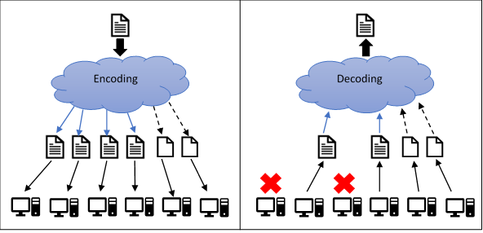
Implementing Redundancy
Erasure Coding
By using Reed Solomon Erasure Coding all the encrypted files will be segmented into 4 pieces plus 2 parity files, then those files will be distributed through the network.
When recreating a file even though two nodes are down file can be recreated using parity files.
Notes:
Original file is broken into 4 pieces, and then 2 parity pieces are added
The Reed-Solomon algorithm creates a coding matrix that you multiply with your data matrix to create the coded data.

Slide 13
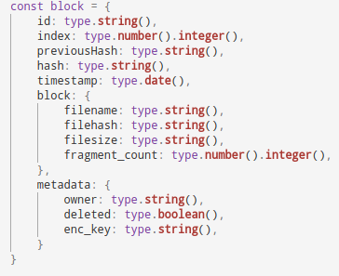
Ensure Consistency
Metadata of files that are uploaded to VAULT is stored in a custom blockchain.
This blockchain will act as an immutable distributed ledger while serving as a DHT (Distributed Hash Table)
This will establish an immutable timeline of how files were accessed.
It will also establish nonrepudiation such that as user won’t be able to deny an action done on their behalf.
Blockchain Technology

Slide 14
Building Security
Authentication - Users & Nodes
File security using a master key symmetric encryption that will enable to encrypt the data rapidly.
Security when sharing the files with another user and security when storing the files via a unsecure chanel
File integrity check
This will reduce the the possibility of an attack carried out by rouge nodes
PKI based key derivation

Slide 15
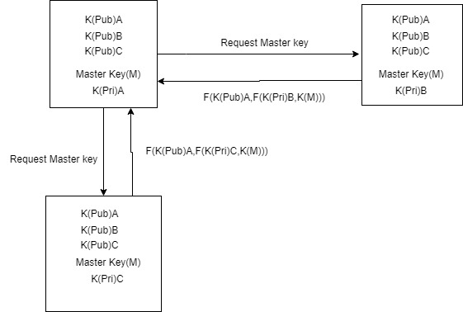
Node Authentication
Every user has master key pre configured for encryption and decryption of the file.
Every user has a list of public keys of every user stored in the custom blockchain.
The Master key(M) will be sent via public and private key encryption.
By comparing the master key will verify the user node is not rogue and the inner layer of encryption authenticate the node.

Slide 16
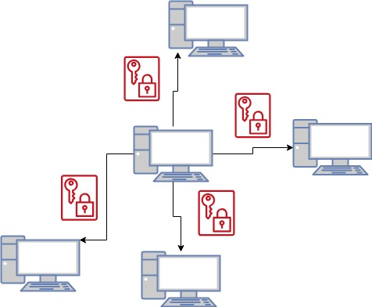
Security when sharing the files
A link will be shared with the intended user that has the locations of the file parts that are stored in the network.
With that link, the user can access the file by downloading the file into the storage.
The master key will be used to decrypt the file.
Inorder establish a secure connection with the user to send the link, public key encryption will be used.

Slide 17
File security and Integrity
Symmetric encryption scheme will be used to encrypt the data that is in the initial stage.
This Master key is used for encryption and decryption of the files.
Although the receivers has the same master key, that master key is useless without all the parts of the files, thus leaving an attack on the network rendered useless
The integrity will be checked as well using the hash values of the files that are stored in the custom blockchain.

Slide 18
Managing virtual storage pool
Virtual storage pool incorporates the health and operational states of data storage techniques.
Virtual storage pool technology, which allows multiple attached physical disk to be used as single instant virtual space.
Virtual storage pool describes the health and operational states of data storage.
Main objectives of virtual storage pool.
Physical disk that are added to a storage pool.
Virtualizing the storage
Create virtual disks from free space in the pool.
Dynamic storage allocation algorithm
Notes:
to Binura
references : http://www2.cs.uregina.ca/~hamilton/courses/330/notes/allocate/allocate.html

Slide 19
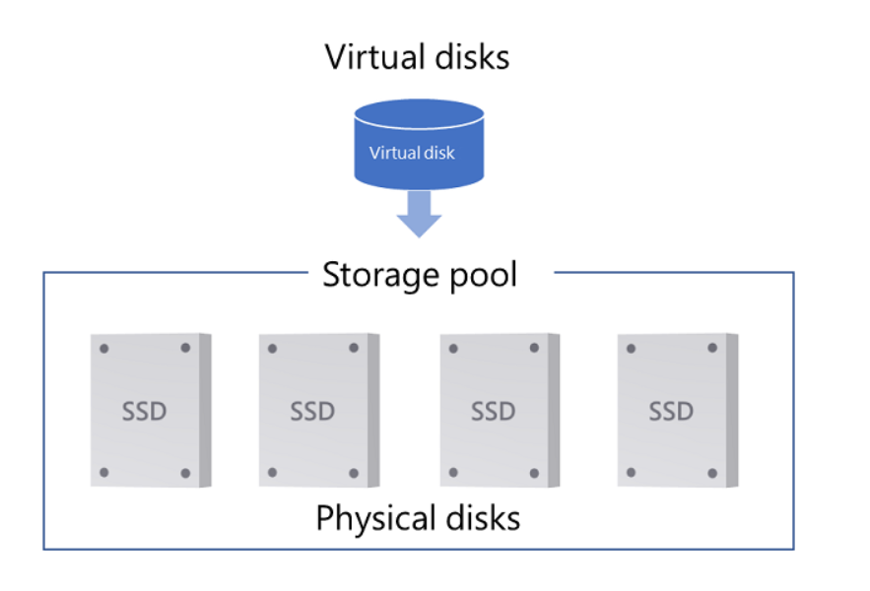
Three basic operations in dynamic storage management.
Allocate
free
Deallocate
Used explicit & implicit form for allocation & deallocation.
Disk allocation mechanism
contiguous allocation
linked allocation
indexed allocation
Disk health monitoring attributes
Temperature
R/W speed
sectors performance
seek performance
Notes:
blocked linked together in a list and the allocation and deallocation can done quickly with less or no storage overhead.

Slide 20
Research Methodology

Slide 21
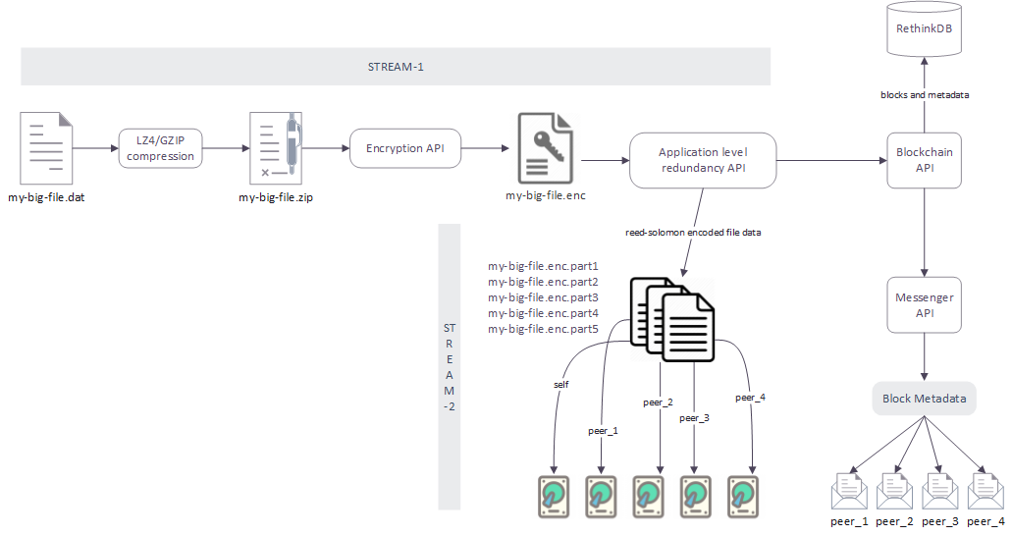
Upload

Slide 22
Download

Slide 23
System Architecture and Process

Slide 24
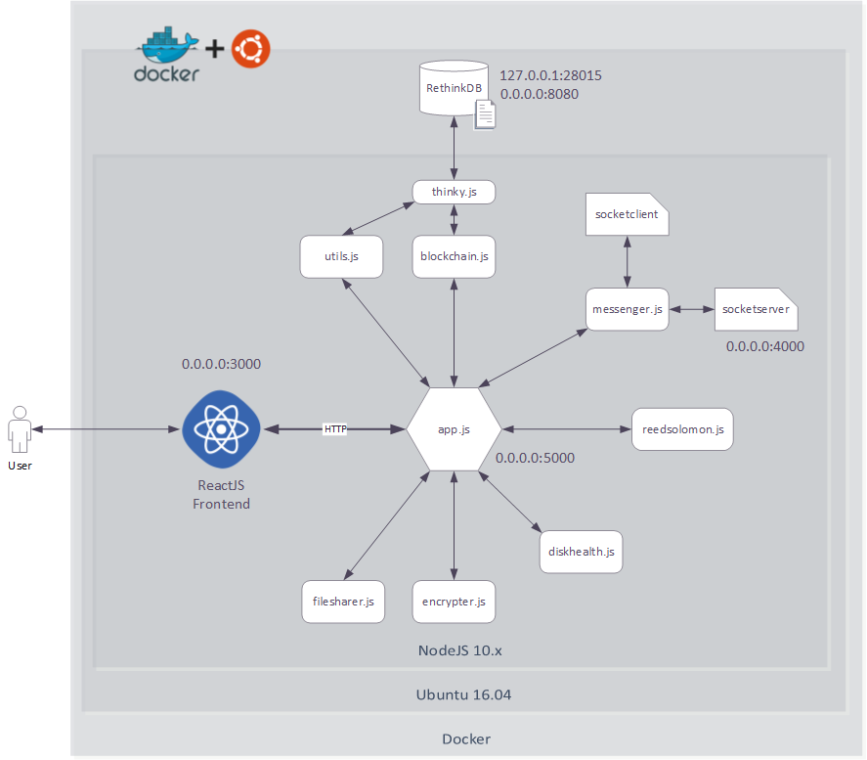
VAULT - High level architecture

Slide 25
Secondary considerations
Volunteer Computing
Dynamic storage allocation based on usage
a peer can volunteer space to the main pool
Gossip Protocol
Communicate with peers through websocket connections. Relay messages like,
block-data messages
blockchain synchronization messages
configuration changes
Integrity Validation
Integrity of files that are pushed or pulled from VAULT will be validated using SHA-256 hashing

Slide 26
Similar Applications

Slide 27





OCFS2
Blue Whale File System (BWFS)

Slide 28
Uniqueness
Data redundancy
Use of less storage media for recover data when file crashes
Security (AES-256-CBC)
Platform Independency (Dockerization)
Easy Installation & Setup
File Sharing
Use of Blockchain (Non Repudiability)

Slide 29
Individual Research Components

Slide 30
T.R.N.R Peiris
K.V.A Sachintha
Redundancy handling
hardware monitoring
Custom blockchain
websocket based peer pairing
Identity management
key derivation for file sharing and encryption
Storage allocation mechanism
device removal protocol
B.A Ganegoda
W.M.U.K.M.T Bandara

Slide 31
Objectives

Slide 32
Creating an easy to use, secure, distributed application to make use of idle/unused storage space on networked computers

Slide 33
Specific Objectives
Involve a Blockchain Ledger
File sharing capability
Parallelized download capability
Dynamic and static storage allocation methods
Secure data handling
Participate in competitions

Slide 34
Tools and Techniques

Slide 35
Tools
docker
docker-compose
NodeJS
cryptoJS – SHA256 hashing library
socket.io – popular websocket library
thinkyJS – ORM for RethinkDB
Ubuntu docker image
RethinkDB NoSQL database
ReactJS
Techniques
Stream Processing
Asynchronous / non-blocking execution
PKI (Public Key Cryptography)

Slide 36
Commercialization

Slide 37
This application could be commercialized specially to large organizations with a considerable amount of workstations.
These workstations can run VAULT per an administrative policy, thus making use of available storage space.
e.g : SLIIT - Free and unused space on staff workstations could be made use by installing VAULT on them. An administrator could then push data to the swarm instead of saving them on cloud / onsite infrastructure.

Slide 38
Expected Outcomes

Slide 39
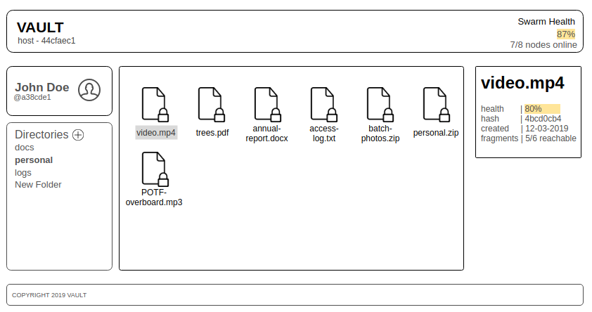
A distributed application with a user friendly Web User Interface that implements redundancy and non-repudiability along with better performance.

Slide 40
References

Slide 41

Thank You!

